Slide 2
From Year 13
3.5.3 Encryption protocols
• show awareness of the purpose of Secure Socket Layer (SSL)/Transport Layer Security (TLS)
• show awareness of the use of SSL/TLS in client-server communication
• show awareness of situations where the use of SSL/TLS would be appropriate
3.5.4 Malware
• show understanding of malware: viruses, spyware, worms, phishing, pharming
• describe vulnerabilities that the various types of malware can exploit
• describe methods that can be used to restrict the effect of malware
From Year 10
1.4.2
show understanding of how data are kept safe when stored and transmitted, including:
– use of passwords, both entered at a keyboard and biometric
– use of firewalls, both software and hardware, including proxy servers
– use of security protocols such as Secure Socket Layer (SSL) and Transport Layer Security (TLS)
– use of symmetric encryption (plain text, cypher text and use of a key) showing understanding that increasing the length of a key increases the strength of the encryption
1.4.3
show understanding of the need to keep online systems safe from attacks including denial of service attacks, phishing, pharming

Slide 3
SSL and TLS
SSL = Secure Socket Layer
TLS = Transport Layer Security
TLS is a version of SSL
SSL is a way to keep your data secure when sending data over the internet.

Slide 4
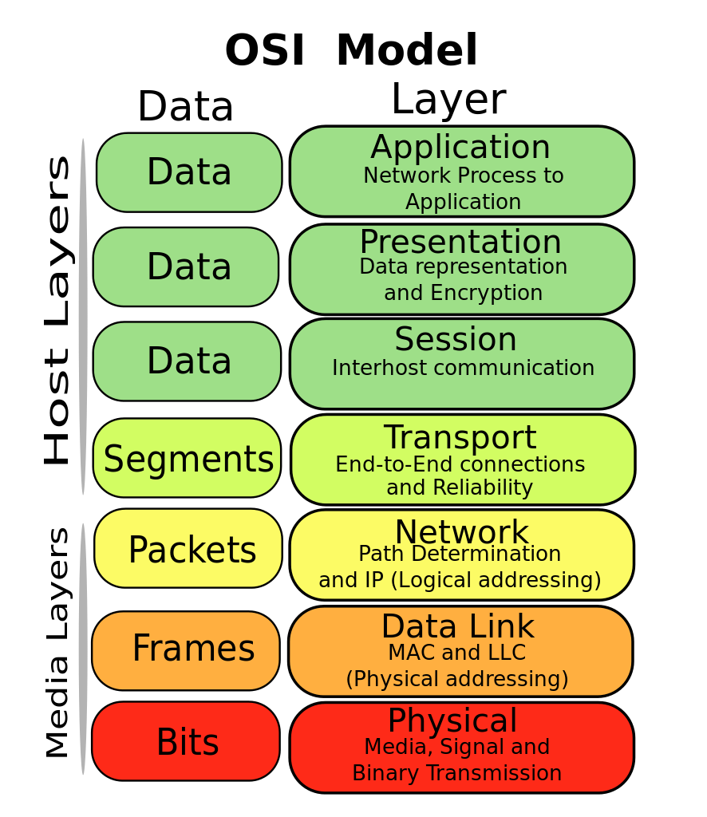
Layers
Data that needs to be sent over a network / Internet passes though different layers.
The framework for the layers is called the OSI Model
OSI = Open Systems Interconnection Model
The internet uses a different set of layers called TCP/IP
TCP/IP = Transmission Control Protocol / Internet Protocol
TCP/IP is based of the OSI model.

Slide 5
Layers
Now when you want to send data from one computer to another, you need to know the senders IP address.
And depending on the type of data, a port number is used.
Port 80 is used for HTML
Port 21 is used for FTP
Port 25 is used for SMTP
The combination of a port number and an IP address is called a socket

Slide 6
SSL
Secure Socket Layer (SSL) – when its used it becomes an additional layer in the TCP/IP model. It goes between the transport and application layer.
And HTTP will become HTTPS
But so what? What does SSL do and how does it work?
SSL makes sure your data is being sent securely
The stages for SSL are:
A client and server make a connection
The client and server agree to what encryption to use
The client and server may swap digital certificates
Once data has been sent, the session is closed.
Steps 1-3 are known as the handshake protocol

Slide 7
How it works
SSL uses keys to make sure that
Your data is private
You know the person you are sending to (identity authentication)
Reliability – SSL checks the message
And it uses a mixture of symmetric and asymmetric encryption

Slide 8


Encryption
Bob wants to send a message to Alice

Slide 9

Encryption
Bob doesn’t want his mum to find out the message

Slide 10
Encryption
I love you!
Will Bob’s mom understand this message?

Slide 11
Encryption
I love you!
Bob needs to encrypt his data

Slide 12

Symmetric Encryption
I love you!
Bob takes his message
He encrypts it using an encryption method:
Maybe his method is
A=1, B=2, C=3, D=4
This method is called a key
So his message is now:
9 12 15 22 5 25 15 21

Slide 13
Encryption
9 12 15 22 5 25 15 21
Bob sends his encrypted data and the Key to Alice, so Alice can read and decrypt his message
This key is PRIVATE KEY because only Bob and Alice have it

Slide 14
Encryption
YOU’RE CRAZY!
9 12 15 22 5 25 15 21
But if mom gets the key…then she can read / decrypt all of the messages between Bob and Alice

Slide 15
Symmetric Encryption
+ Simple
+ Quick
- You have to share your key
If someone gets your key then they can read everything

Slide 16
Asymmetric Encryption
Uses two keys
One key is PRIVATE – only you have this – you share this with NOBODY! Its yours, you love it, its more important than your life.
Another key is public – you can share this with anyone and anyone can know this

Slide 17
Alice uses asymmetric encryption.
She has a private key and a public key
Private Key
Public Key

Slide 18
Private Key
Bob can encrypt his message using Alice’s public key.
Public Key

Slide 19
ANYONE, including Bob’s mom can see this. But its still encrypted
Private Key
Public Key

Slide 20
The only thing that can decrypt is Alice’s private key
Private Key
Public Key

Slide 21
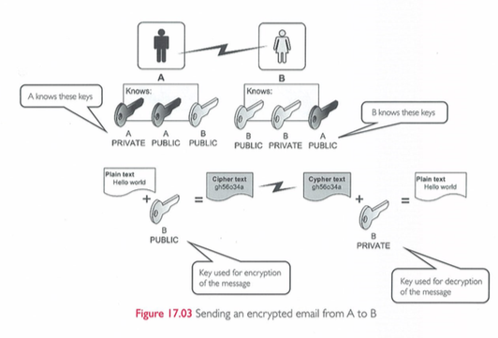
SSL and Emails
If you want to secure an email. You’ll just use SSL with normal asymmetric encryption

Slide 22
SSL and Email and Digital certificate
Because you have to type in the email address of the person you are sending it to, you don’t need to add a digital certificate.
But if you are sending data to a website (like your login data or credit card) you want to know the person you are sending your data to is actually the person who will get the data.
This is a digital certificate

Slide 23
Digital certificate
We need to talk about key pairs.
When keys are made, they are made in pairs
So if someone encrypts with your public key then they know only you can read with your private key. Public can be read with private
But it also works in reverse.
Private can be read by public
But WTF….everyone can have my public key, so what’s the point of encrypting with my private
So for example, if Alice wants to send to Bob, she encrypts with her private and Bob can decrypt with Alice’s public….but everyone has Alice’s public key so all she’s done is make sure that everyone knows the message came from her – but everyone can still read it and she only wants Bob to read

Slide 24
Key Pairs
Because Alice starts off with two keys, a public key and private key, we call this a key pair. Her two keys are used to encrypt and decrypt data.
What is a key? Its just a big number with a mathematical algorithm applied to it. You cannot* tell what the private key is based on the public key, they are different keys with different algorithm applied to it but it still produces the same result.
All keys in asymmetric encryption are done as key pairs and all you have to do is say what key pair you are using. (You do this by sending out your public key)
*You can but it’s a very long process…when we do PHP we will do MD5 hashing and show you this.

Slide 25
Issues during transmission
We said before that an issue during transmission was confidentiality, making sure only the recipient can decrypt the ciphertext.
Does symmetric encryption allow this?
Does asymmetric encryption allow this?
Symmetric = No, because Bob’s mum can decrypt if she stole the key
Asymmetric = Yes, because only Alice’s private key can decrypt

Slide 26
Authenticity
When the receiver must be sure of who sent the ciphertext.
If Alice took her plaintext message, and then she encrypted it with her private key, knowing that her public key can decrypt (because it’s a key pair) and knowing that anyone can have her public key….is there a point of doing that? To encrypt data with private knowing that your public key can decrypt?
Yes, this ensures authenticity. Because you can decrypt with Alice’s public key, you know it had of been written with the other key in that key pair, it had of been written with Alice’s private key. It had to be written by Alice because only she has her private key.
It may ensure authentication but it sucks for encryption because anyone can decrypt using the public key. So what can we do?

Slide 27
Private + Public
Alice encrypts her data with her private key.
This makes sure that people know its from Alice.
But right now everyone can decrypt because everyone has Alice’s public key. She only wants to send a message to Bob.
So she takes her message, which has been encrypted with her private key and then she further encrypts it with Bob’s public key.
Now only Bob can decrypt with his private key and then uses Alice’s public key to get to the original data. We have confidentially
So now we have confidentiality and authenticity.

Slide 28
Digital Signature
Remember when we said if Alice uses her private key to encrypt data, then it sucks for making sure the data is secret but its good for knowing the message came from Alice.
This is a digital signature.
It can confirm that Alice was the person who wrote the message, she had to, it came from her private key. It is her digital signature.

Slide 29
Integrity
Making sure the data is not altered
So far if Alice encrypts data with her private key (authentication with digital signature) and also uses Bobs public key to encrypt the same data (confidentially), how can we make sure of integrity. Making sure that no one can change the encrypted data.
We need to have something called a digest. (Stupid word for it)

Slide 30
Digest
Your original plaintext message goes though a (cryptographic) hash function.
Hash = Some maths is applied to your message to make a number.
MD5 is a popular hash method and it takes your message and from that gives a 128 bit number.
This number, the number made from your message after the hash function, is called your digest.
This digest is then encrypted with your private key to get your digital signature.
This is cryptographic one way hash function

Slide 31
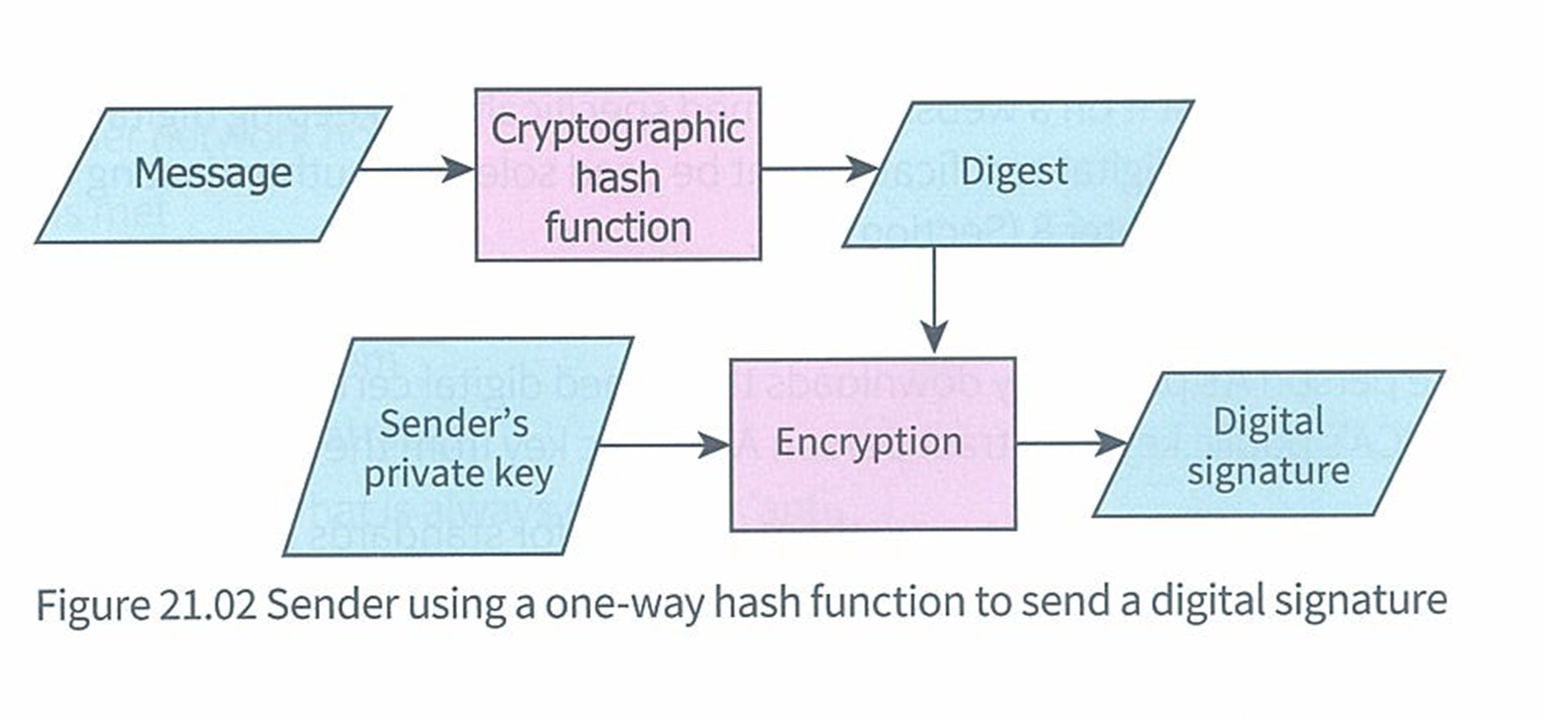
Cryptographic one way hash function
So now we have a hashed message included with our digital signature which has been made with our private key and can only be unlocked with our public key

Slide 32
Integrity using digests
Bob gets a message from Alice.
He uses the same hash function (but in reverse) that Alice used in her message. So now Bob has a big long number.
Bob also has Alice’s digital signature which he uses her public key to decrypt.
So now Bob has two pieces of information.
The digest that Alice produced from her message and the digest of Alice’s digital signature.
These two digests are compared. If they are the same then we know the message is fine. If the numbers are different then we know something bad happened

Slide 33
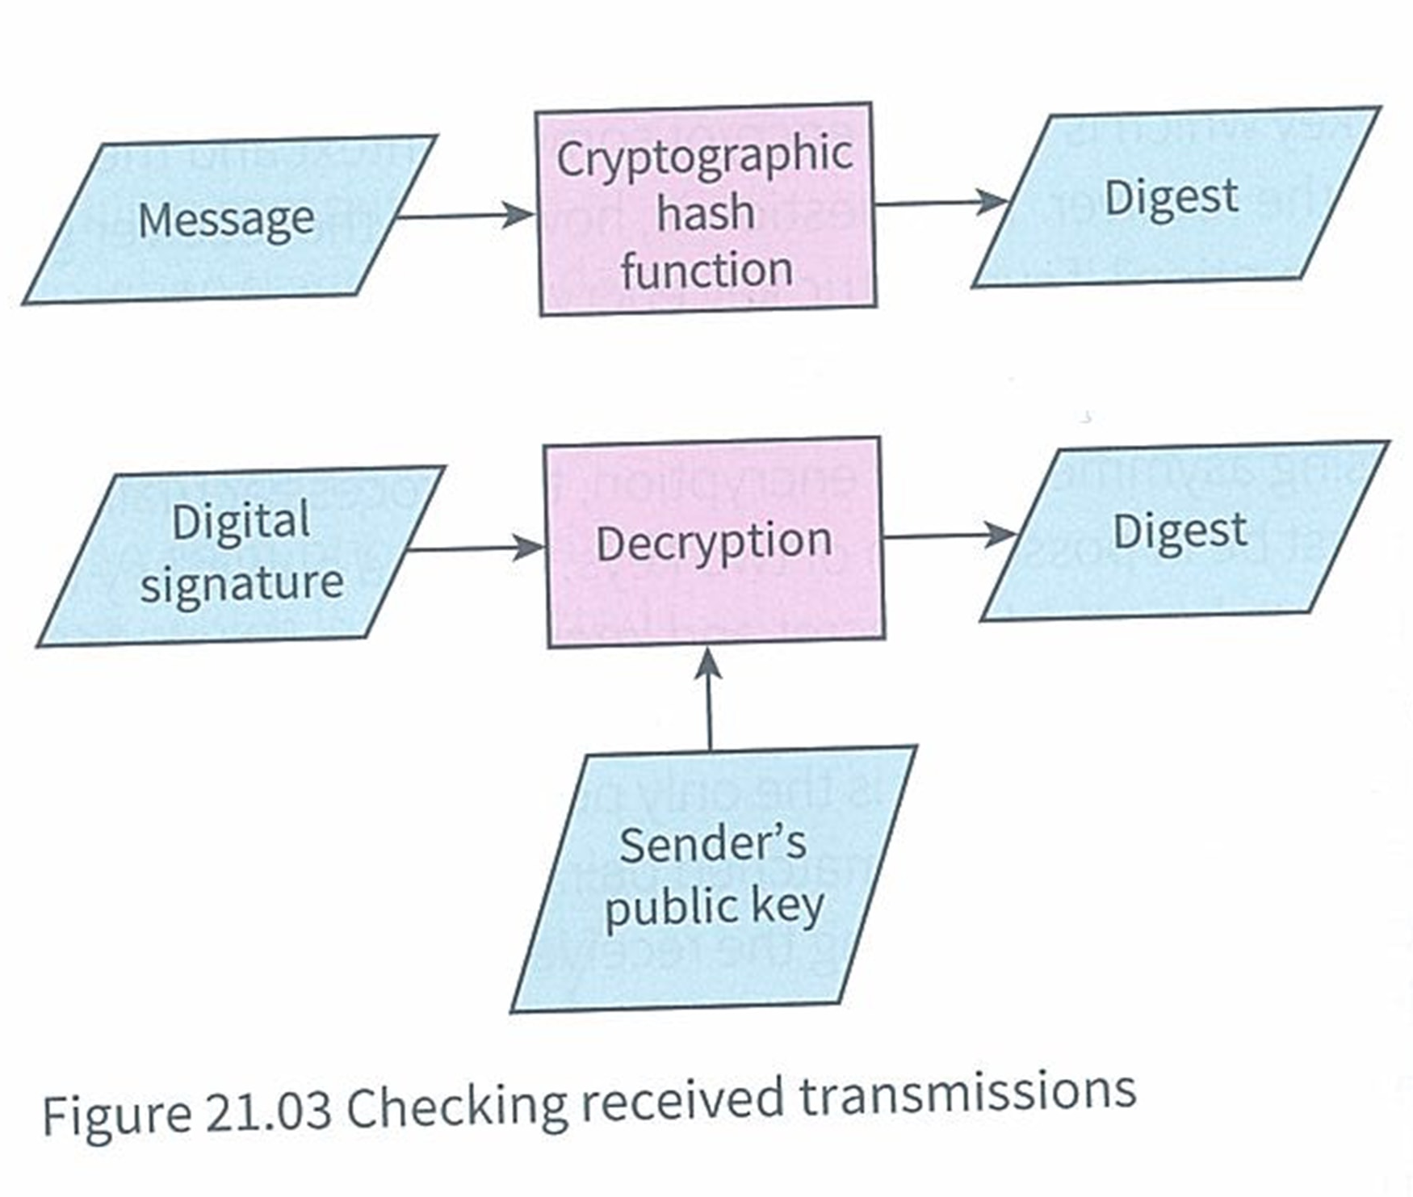
What Bob does to ensure Alice’s message is good

Slide 34
BIG BIG PROBLEM
Alice encrypts and signs her data. Using her private key and possible Bob’s public key…..but how does she know Bob’s public key is actually Bob’s??
You know a public key and private key are created as pairs, so we know if something is sent that used a private key then only the corresponding public key should open it….but what if something like we just saw uses public keys to encrypt.
Bob has to verify that his public key really belongs to him and Alice must be able to make sure that this is true
This is where we need someone else. Someone we trust. We need a certificate authority (CA)

Slide 35
Certificate Authority
A CA is a large, well known and trusted company. Like Symantec or GlobalSign or Comodo.
Bob has to call up or visit one of their offices. He has to take his ID, such as passport, driving licence, bank statements to them so they can physically check its him.
At the same time he must also give them his public key.
If the CA are happy that Bob is really Bob then they take all this data. His ID and his public key and they add the CA information (name of their company, date when certificate was issued, how long the certificate is valid for)

Slide 36
CA
All three things, Bob’s ID, his public key and the CA information are then hashed.
This gives a very long number. This is now a unsigned digital certificate
The CA then uses their own private key, the private key of the CA to encrypt the hash number. This is now a signed digital certificate.
This is Public key signed digital certificate. Its public because Bob used his public key.
Alice still must check that its really Bob. So she takes Bob’s ID, his public key and CA information and she hashes it. She now has a big number
She then uses the CA’s public key to decrypt the signature and gets a big number. If the numbers match then she can be sure its Bob.
The whole method of Bob getting a public key digital certificate is one part of the PIK – Public Key Infrastructure.

Slide 37
Video questions
1: How many hash functions are used in total?
2: How many keys are used in total?
3: What key signs the certificate?
4: How do you know the certificate has been properly signed?
5: Does the CA public key or private key decrypt the hash code?

Slide 38
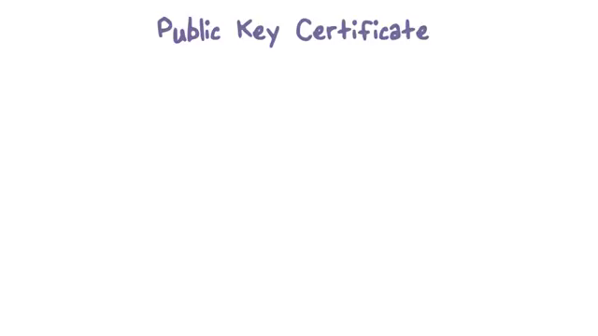

Slide 39
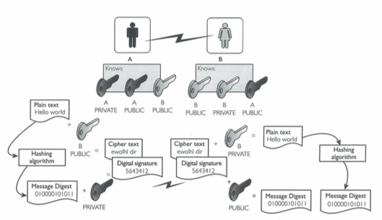
Digital Certificate from Cambridge

Slide 40
SSL connections
So that was how a digital certificate is made and used.
But that still does not make sure your actual connection is secure.
For that we need to connect to the server in a secure way.
Your browser asks the server to identify itself
The server sends its certificate and the server public key
The browser checks this certificate with a list of CA’s it has built in
If browser trusts it encrypts a session key using the server’s public key. This is one half of symmetric encryption. But now the sever needs a session key.
The server can decrypt the session key by using the server private key
The sever sends an acknowledgement saying its all okay to send by sending the session key
Now the server and browser encrypt all data using the session key

Slide 41
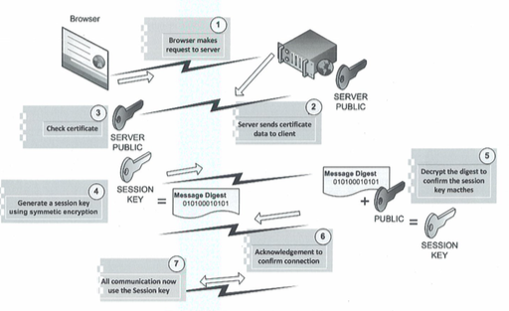

Slide 42
Malware
Malware = The word used to describe any software that wants to harm / damage your computer.
There are many ways malware can hurt your computer.

Slide 43
Malware
Browser Hijackers
When you load your browser, malware code is run. A common hijack is when it records all your keystrokes
Ransomware
Locks your computer and/or deletes your data until you pay the hacker some money
Backdoor access
To login into your computer without being an actual user
Trojan horse
Makes itself look like useful software, so you are dumb enough to install it and then something bad happens.

Slide 44
Malware
Worms
Malware designed to spread to other computers
Adware
Malware that makes adverts pop up when you don’t want them to
Spyware
This is a term that includes Trojan horses, adware, cookies tracking and malware software to monitor your system

Slide 45
Hackers
Hackers
Someone who tries to get control of your system without permission
Why:
Curiosity : See what you have
Money : Your information may be valuable
Personal belief : They think they have a right
How to protect:
Firewall
Strong passwords

Slide 46
User ID and Password
User Identification
Password
Unique combination of an identifier and a password
Used to log in to websites
Need a strong password
Can be guessed

Slide 47
Strong Password
Long
Numbers and letters (Capital letters and lower case)
Punctuation marks (!@£$%^&*)
Change it often
Don’t tell anyone

Slide 48
Biometrics
When features of your body are used to gain access
Face, Eyes (Retina), Fingerprint, Hand, voice, gait
+ More secure as your body parts don’t change so you won’t forget
+ More secure as someone will have to rip out your eye if they want to use it
A video from Hannah Year 10

Slide 49
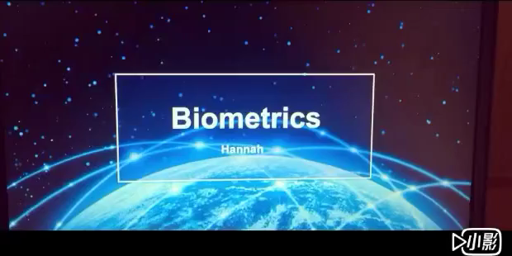

Slide 50

SSL and Digital Certificates

Slide 51

Phishing

Slide 52
Smishing
Phishing = Fake email sending you to a fake website
Smishing = Fake SMS text sending you to a fake website
Smishing = SMS Phishing

Slide 53
Pharming
Phishing and Smishing means either you get an email or SMS and you have to click on a link to go to a fake website.
But what if you type in a real address….an address you know, an address you trust….and it stills go to a fake website
That’s Pharming

Slide 54
Pharming
Normally:
You type a web address
That gets sent to a DNS server which converts your web address into an IP address
Then that goes out over the internet to a web server
Then the webpage you want gives you the page
With Pharming
You type a web address
That gets sent to a DNS server which converts your web address into an IP address
But that DNS server has been attacked by an evil person
So even though you typed a real page address the IP it gets translated to will go to an evil persons server
Then that fake webpage gets shown to you….and you don’t know.

Slide 55
Pharming

Slide 56
